Slide 1


Computational Skills for Researchers
Intro to Quest
Alper Kinaci, Sr. Computational Specialist
Research Computing Services
https://github.com/nuitrcs/intro-quest-ciera-workshop

Slide 2
Learn About
Quest System Architecture
Job Scheduler & Software
Parallel Computing
Getting Started: Logging in, file transfers, batch & interactive job submission

Slide 3

High Performance Computing

Slide 4


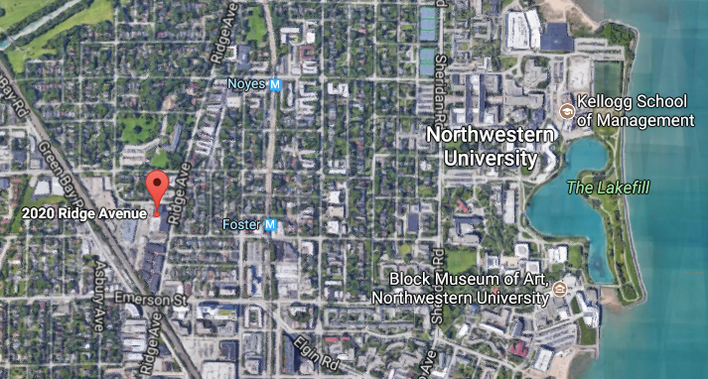
Quest: High Performance Compute Cluster
24 hour on-site security, 3-factor authentication,
firewalls and intrusion detection systems,
dedicated power station, high-throughput network

Slide 5
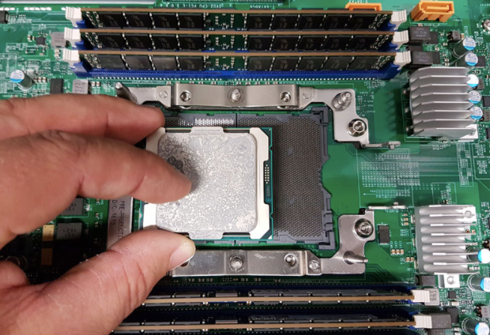
Quest: High Performance Compute Cluster
“node”: a computer
>670
“core”: a processor
~18,000
Notes:
over 100TB of RAM total

Slide 6
Quest: High Performance Compute Cluster
Desktop vs. Quest
Processor Speed: 2.2 GHz
Number of Processors: 1
Total Number of Cores: 2
L2 Cache (per Core): 256 KB
L3 Cache: 4 MB
Memory: 8 GB
1
Processor Speed: 2.5-3.3 GHz
Number of Processors: 2
Total Number of Cores: 24+
L2 Cache (per Core): 256 KB
L3 Cache: 30 MB
Memory: 128 GB
670+
Notes:
over 100TB of RAM total

Slide 7

Quest: High Performance Compute Cluster
“infiniband”: high-speed
inter-connect
nodes in racks

Slide 8


Quest: High Performance Compute Cluster
Access, compute & storage
670+ compute nodes
3.5 PB
128 GB or 96 GB RAM
/home/netID
/projects/p123xx
Infiniband
/projects/b1xx
Submit job
quser21
quser22
quser23
quser24
login nodes
ssh netID@quest.northwestern.edu

Slide 9

Quest: High Performance Compute Cluster
Node Architectures: 3 Generation of Nodes
670+ compute nodes
128 GB RAM (Q5, Q6)
96 GB RAM (Q8)
Q5 → 24 cores/node
Q6 → 28 cores/node
Q8 → 28 cores/node
Q5
Q6
Q8

Slide 10



Quest: High Performance Compute Cluster
Job Scheduler

Slide 11


Quest: High Performance Compute Cluster
login node
compute node
“sbatch submit.sh”
compute node
compute node
SLURM
scheduler
compute node
#SBATCH -A <allocationID>
#SBATCH -p <queue_type>
#SBATCH -N 1
…
…
compute node

Slide 12
Quest: High Performance Compute Cluster
Software
Operating system
Loadable modules
https://kb.northwestern.edu/quest-software

Slide 13
Quest: High Performance Compute Cluster
Parallel Computing
ACTIVITY

Slide 14
Quest: High Performance Compute Cluster
Parallel Computing
Multiple jobs working independently
“embarrassingly parallel”
“pleasingly parallel”
high-throughput computing
Single job communicating across nodes
message passing:
MPI, Spark, OpenMP

Slide 15
Getting Started: Logging in
Mac users: launch the Terminal App
PC users: launch Git Bash
Linux users: launch the Terminal App

Slide 16
Getting Started: Logging in
Connect to Quest using ssh (secure shell)
$ssh <NetID>@quest.northwestern.edu
Print working directory
$pwd
Names of your allocations (storage in /projects/<allocationID>)
$groups
Summarize disk usage in your home folder
$du -h ~
Logout from Quest, return to your computer
$logout

Slide 17
Getting Started: Software modules
Connect to Quest using ssh (secure shell)
$ssh <NetID>@quest.northwestern.edu
Check the version of Python
$python --version
Python 2.7.5
It seems system has python 2.7. Can we use python 3.6?
Check available software provided by modules
$module avail
Load python/anaconda3.6 (to use python 3.6)
$module load python/anaconda3.6

Slide 18
Getting Started: Software modules
Let’s see if the module is loaded
$module list
Let’s check the version of Python again
$python --version
Python 3.6.0 :: Anaconda 4.3.0 (64-bit)
Now python 3.6 can be used
Unload python/anaconda3.6 module
$module unload python/anaconda3.6
Check python version
$python --version
Python 2.7.5

Slide 19
Getting Started: Clone GitHub Repo
Logout from Quest, return to your computer
$logout
Clone the GitHub repository
$git clone https://github.com/nuitrcs/intro-quest-ciera-workshop
Change directory to cloned folder
$cd intro-quest-ciera-workshop
List the files/folders in the cloned folder
$ls
Change directory to the parent folder
$cd ../

Slide 20
Getting Started: File transfers
To connect to Quest, start Cyberduck and then :
1) Click Open Connection in the upper left of the Cyberduck window
At the top of the Open Connection window that appears, Select SFTP (SSH File Transfer Protocol) from the drop-down menu.
2) Enter quest.it.northwestern.edu for server specification
3) Enter your NetID in the Username: box and leave the Password: box empty to prevent your NetID password from being saved in a file on your personal computer. Public Key Authentication is not supported.
4) Click Connect. You will see a Login failed window.
5) Enter your NetID password in the Password: field.
6) Click Login.​

Slide 21
Quest: Transfer with Cyberduck
On your local machine
Drag "intro-quest-ciera-workshop” folder into your Quest home directory in Cyberduck
Connect to Quest using ssh (secure shell) from Git Bash
$ssh <NetID>@quest.northwestern.edu
List the files/folders in the home folder
$ls
Change directory to copied folder
$cd intro-quest-ciera-workshop
List the files/folders in intro-quest-ciera-workshop folder
$ls

Slide 22
Quest: Transfer with sftp
Logout from Quest, return to your computer
$logout
Remove (i.e. delete) cloned folder from your computer
$rm -Rf intro-quest-ciera-workshop
List the files/folders to see if the folder is removed
$ls
Connect to Quest with secure file transfer protocol (sftp)
$sftp <NetID>@quest.northwestern.edu
Download intro-quest-ciera-workshop folder to your computer
>get -r intro-quest-ciera-workshop

Slide 23
Quest: Transfer with sftp
List existing files on Quest
>ls
Locally list existing files (i.e. in your computer)
>lls
Change directory to cloned folder on Quest
>cd intro-quest-ciera-workshop
Remove “submit_generic.sh” file on Quest
>rm submit_generic.sh
List existing files in intro-quest-ciera-workshop
>ls

Slide 24
Quest: Transfer with sftp
Locally change directory to cloned folder (on local computer)
>lcd intro-quest-ciera-workshop
Upload “submit_generic.sh” to Quest
>put submit_generic.sh
List existing files on Quest again
>ls
Quit sftp, return to your computer
>quit
Print working directory
$pwd

Slide 25
Quest: Transfer with scp
Change directory to “intro-quest-ciera-workshop” folder on your
local computer.
Remove “submit_generic.sh” file from your computer
$rm submit_generic.sh
List existing files in intro-quest-ciera-workshop
$ls
Secure copy “submit_generic.sh” from Quest to your computer
$scp <NetID>@quest.northwestern.edu:~/intro-quest-ciera-workshop/submit_generic.sh ./submit_generic.sh
List files in intro-quest-ciera-workshop on your computer
$ls

Slide 26
Getting Started: Batch Job Submission
Connect to Quest and move to cloned folder
Concatenate (print out) submission script, “submit_generic.sh”
$cat submit_generic.sh
#!/bin/bash
#SBATCH --account=<allocationID> ## <-- EDIT THIS TO BE YOUR ALLOCATION
#SBATCH --partition=<queue_type> ## <-- EDIT THIS TO BE YOUR QUEUE NAME
#SBATCH --nodes=1
#SBATCH --ntasks-per-node=1
#SBATCH --time=00:10:00
#SBATCH --mem-per-cpu=1G
#SBATCH --job-name=sample_job
#SBATCH --output=outlog
#SBATCH --error=errlog
module purge all ## Unload existing modules
module load python ## Load necessary modules (software, libraries)
bash whereami.sh ## Run the program
python helloworld.py ## Run the program

Slide 27

text editor: vi/vim
Getting Started: Batch Job Submission
Open submit_generic.sh with VIM text editor
$vim submit_generic.sh
You land in command mode
To enter insert mode: “i”
Navigate with arrow keys
To exit insert mode: “esc”
To save & exit: “:wq”
To exit without saving: “q!”

Slide 28
Getting Started: Batch Job Submission
What is the scheduler looking for in your script?
This is a BASH script:
#!/bin/bash
#SBATCH --account=w10001
#SBATCH --partition=w10001
#SBATCH --nodes=1
#SBATCH --ntasks-per-node=1
#SBATCH --time=00:10:00
#SBATCH --mem-per-cpu=1G
#SBATCH --job-name=sample_job
#SBATCH --output=outlog
#SBATCH --error=errlog
Account:
Partition/Queue:
Number of nodes:
Number of cores:
Length of the job:
Required memory:
Name of the job:
Generate an output log:
Generate an error log:

Slide 29
Getting Started: Batch Job Submission
Submit your job to batch processing
$sbatch submit_generic.sh
Note your job_id returned after sbatch
What is the status of your job(s) in the queue
$squeue -u <NetID>
Detailed information about the job
$checkjob <job_id>
When the job ends, investigate errlog, outlog and python_output.txt

Slide 30
Getting Started: Interactive Job Submission
(with display)
PC users: Launch Xming
In Git Bash on your local computer
$export DISPLAY=localhost:0
$ssh –XY <NetID>@quest.northwestern.edu
Mac users: Launch XQuartz (may be already running)
In terminal on your local computer
$ssh –X <NetID>@quest.northwestern.edu
Linux users: In terminal on your local computer
$ssh –X <NetID>@quest.northwestern.edu

Slide 31
Getting Started: Interactive Job Submission
(with display)
Alternatively you can use FastX for display
PC, Mac & Linux users: FastX:
Hostname : quest.northwestern.edu
Username : your Northwestern NetID
Password : your Northwestern NetID password
From browser: https://quest.northwestern.edu:3000
Username : your Northwestern NetID
Password : your Northwestern NetID password

Slide 32
Getting Started: Interactive Job Submission
By submitting an interactive job, you can access the command line on a compute node to do your work
submit your job from the command line
$srun --x11 \
--account=w10001 \
--partition=w10001 \
--time=00:10:00 \
--nodes=1 \
--ntasks-per-node=1 \
--mem-per-cpu=1G \
--pty bash -l
→If display is required (optional)
→Starts the bash terminal

Slide 33
Getting Started: Interactive Job Submission
When the job starts on a compute node, run matlab graphical user interface (GUI)
Check available matlab modules
$module avail matlab
Load matlab/r2018a module
$module load matlab/r2018a
Run matlab
$matlab
Close GUI and logout from the interactive session
$logout

Slide 34
Getting Started: Job Submission Examples
Jobs on Quest
https://kb.northwestern.edu/page.php?id=69247
Example Jobs
https://kb.northwestern.edu/page.php?id=70719

Slide 35
Questions?
email: quest-help@northwestern.edu
Research Computing Services

